Slide 1
INF130
Queries to one table (Enkle spørringer)

Slide 2
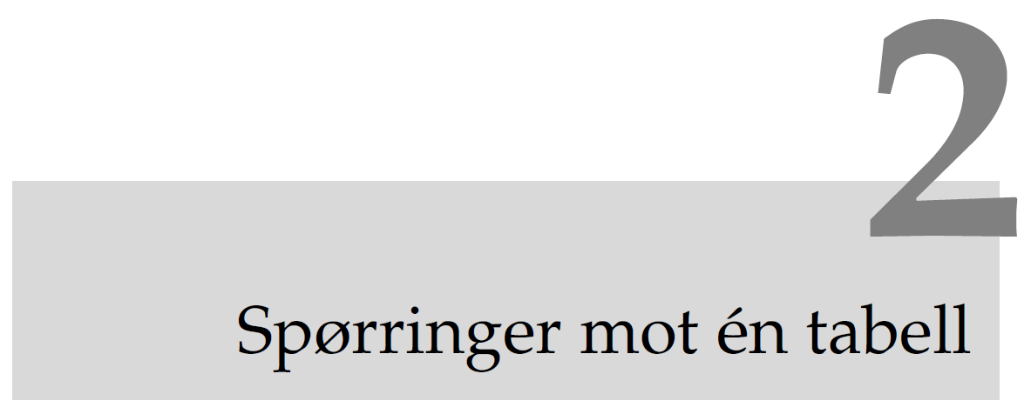
Bjørn Kristoffersens bok

Slide 3
Learning goals
Know important areas where SQL is used
Know how to use SQL to make queries to one table
Know how to choose columns and rows
Know how to sort rows with respect to certain columns
Know how to compute sum, average, etc.
Know how to use functions and operators

Slide 4







Environments
computer
Web-server
Internet
DBMS
Terminal/
Kommandolinje

Slide 5
Demonstrations
Make databases
Make tables
Import of database from the book to MySQL
Import of the database University for mandatory exercise
Structures av databases and tables
Insert data into tables

Slide 6

Main groups of SQL tasks
Create new tables and structures
Work with tables
Insert new rows
Delete rows
Update rows
Fetch data
Filtrate
Sort
Group
Connect
User administration
search

Slide 7

Create database and tables (short version)

Slide 8
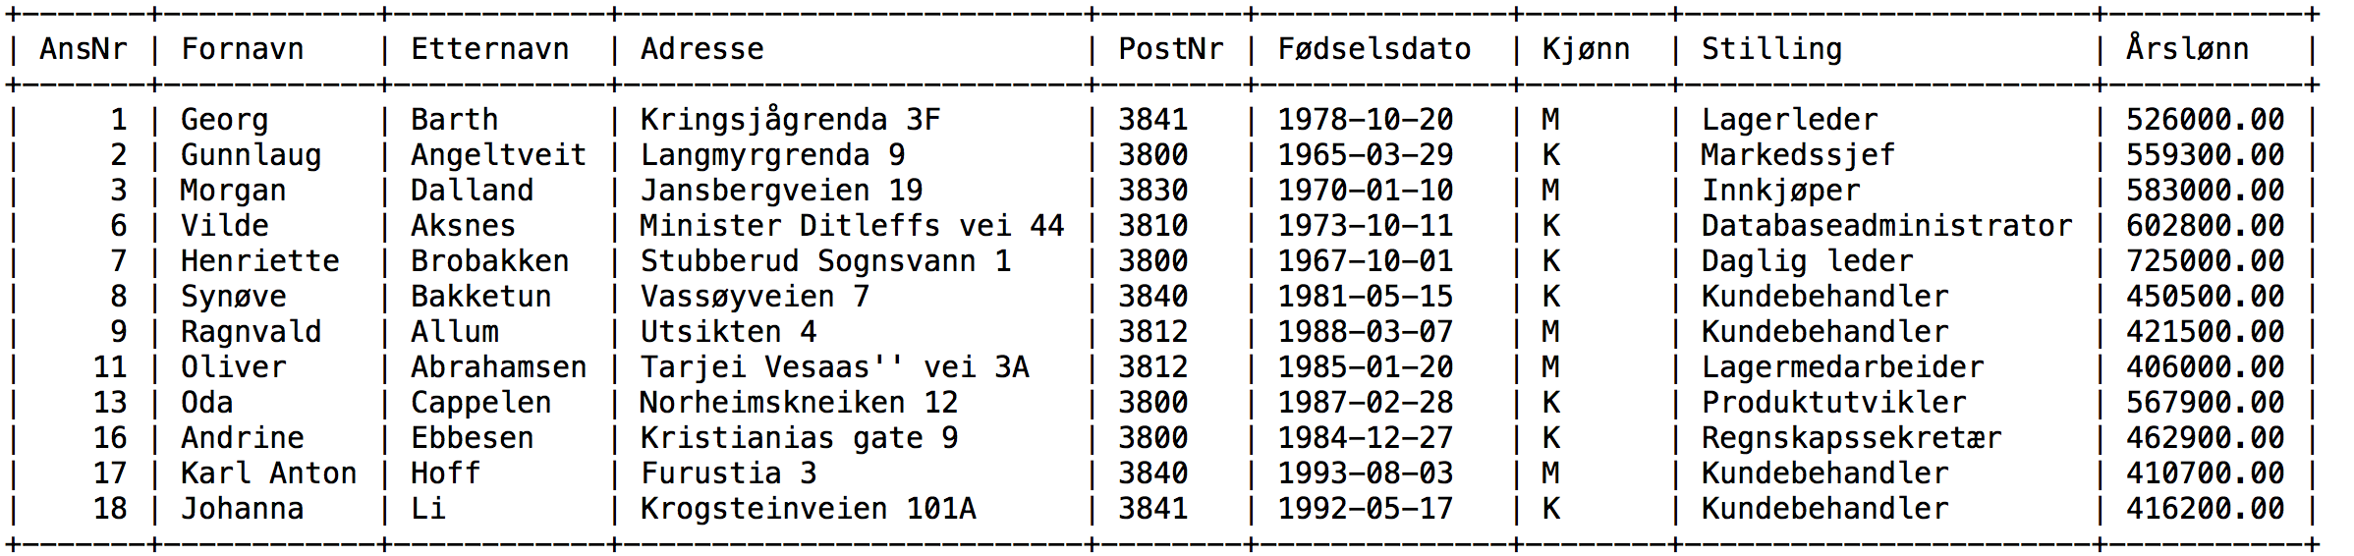
Database table Ansatt

Slide 9
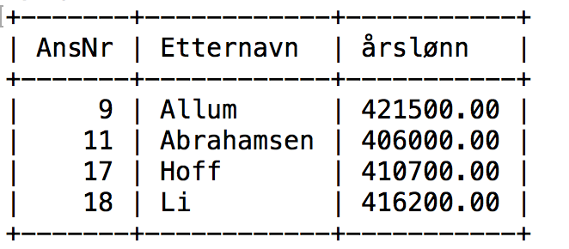
Query
SELECT AnsNr, Etternavn, Årslønn
FROM Ansatt
WHERE Årslønn < 450000
Query result:

Slide 10
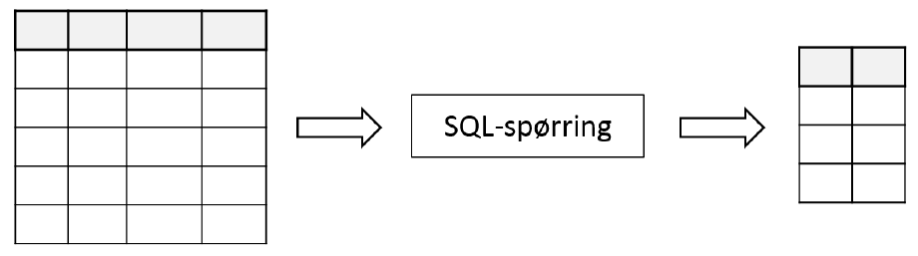
From table(s) to query result
A query takes tables as ”input data” and gives a query result as ”output data”, also on table form.
We first look at queries to one table

Slide 11
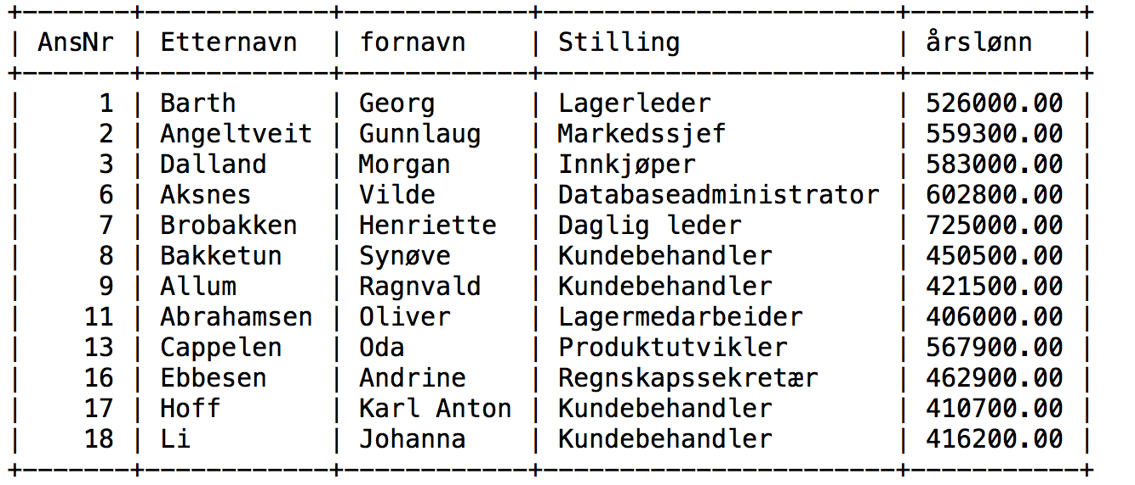
Queries
SELECT AnsNr, Etternavn, Årslønn
FROM Ansatt
WHERE Årslønn < 450000

Slide 12
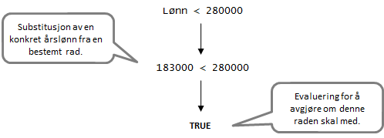
Substitution and evaluation
DBHS carries out the query by going through the table row by row
For each row, concrete values are substituted for the columns
The expression is evaluated to True or False

Slide 13

Computers and formal languages
SQL is a formal language:
Precise rules for what is a legal ”sentence”.
Small typos gives error message eller unexpected result.
Read the error messages !
Interpreting the error messages demands training.
The error messages do not always identify the error precisely
Check that the query is meaningful:
The query can be logically wrong even if we don’t get an errors message

Slide 14
Building blocks in SQL
SQL queries are buildt from:
Reserved words (e.g., SELECT and FROM)
Name on tables and columns (e.g., Ansatt and Etternavn)
Functions (e.g., UPPER) and operators (e.g., <)
dividers (e.g., comma)
SELECT AnsNr, Etternavn, Årslønn
FROM Ansatt
WHERE Årslønn < 450000 AND
UPPER(Stilling) = ’KUNDEBEHANDLER'

Slide 15
Query in SQL (SELECT)
First: Simple queries to one table:
Choose columns
Choose rows
Sort rows with respect to one column
Add computed columns
Group and aggregate data (sum, average etc.)

Slide 16

Select columns
Selecting a few columns:
SELECT AnsNr, Etternavn
FROM Ansatt
Selecting all columns:
SELECT *
FROM Ansatt
If we select one column we may get several equal values These duplicates can be removed:
SELECT DISTINCT Stilling
FROM Ansatt

Slide 17

Select rows
Selecting rows satisfying a certain condition
SELECT *
FROM Ansatt
WHERE Årslønn < 450000
A condition is an expression that is either True or False

Slide 18
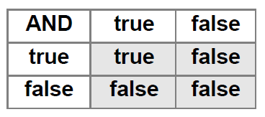
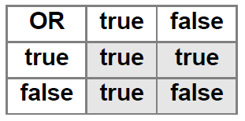
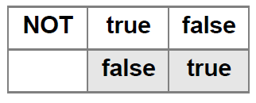
Logic operators AND, OR and NOT
Used to build connected conditions
(Årslønn > 450000) AND
(Stilling = ’kundebhandler')
(Lønn < 300000) OR
(Lønn > 500000)
NOT (Lønn <= 300000)

Slide 19
Use parenthesis!
We wish to find position ”kundebehandlere/selgere” earning more than 450.000,- per year.
SELECT *
FROM Ansatt
WHERE Lønn > 450000
AND Stilling = ’Kundebehandler'
OR Stilling = 'Selger'
Can queries be interpreted in several ways ?
Are there severla ways of placing paranthesis?
What happends first: AND or OR?
What happends if we don’t use paranthesis ?

Slide 20
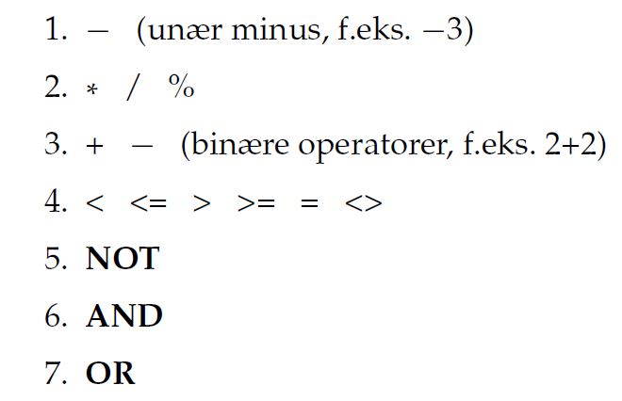
Priority of operators

Slide 21
Sorting and comparisons
To sort we need to compare
Numbers: … -2 < -1 < 0 < 1 < 2 < 3 < …
Letters: a < b < c < …
Texts: adam < anna < anne < anneli < david
Dates: 22.03.1978 < 07.02.1992 < 31.12.2014
Sorting in SQL means sorting rows with respect to a certain colum
Certain of the rows in ”Ansatt” sorted w.r.t. Årslønn:
AnsattNr | Etternavn | Fornavn | AnsattDato | Stilling | Lønn
1 | Veum | Varg | 01.01.1992 | Løpegutt | 183 000.00
2 | Stein | Trude | 10.10.2000 | DBA | 270 700.00
20 | Felgen | Reodor | 12.12.2001 | Sykkelreparatør | 279 500.00
6 | Gredelin | Sofie | 18.05.1998 | Underdirektør | 625 850.00

Slide 22
Sorting in SQL
Sorted namelist:
SELECT AnsNr, Etternavn
FROM Ansatt
ORDER BY Etternavn
Several criteria for sortering:
SELECT Etternavn, Stilling, Årslønn
FROM Ansatt
ORDER BY Stilling ASC, Årslønn DESC
ASC means ascending sorting and DESC means descening.
ASC is standard, so first query is ascending sorting.

Slide 23
Joker and interval search
Find all with ”etternavn” starting with B:
SELECT *
FROM Ansatt
WHERE Etternavn >= ’B'
AND Etternavn < ’C'
Joker is more elegant here:
SELECT *
FROM Ansatt
WHERE Etternavn LIKE ’B%'
Why is Etternavn = ’B%' meaningless ?
Find all with ”etternavn” ending with 'sen' !

Slide 24
Computed columns
It is legal to use expressions with SELECT:
SELECT AnsNr, Etternavn,
Årslønn/12 AS LønnPrMåned
FROM Ansatt
Not necessary to store both ”årslønn” (yearly salary) and ”månedslønn” (monthly salary) !
Årslønn/12 is an expression. In order to get a meaningful title in the output we give this columns a name.

Slide 25
Functions
Text, e.g., names, can be set with capital letters
SELECT AnsattNr, UPPER(Etternavn)
FROM Ansatt
UPPER is a function (MySQL).
A function can have several arguments, but only one return value
There are many functions, see MySQL documentation on the internet
UPPER

Slide 26
Test of functions in MySQL
To get experience in how functions work you may write expressions in a query without the FROM part.
SELECT UPPER('Hansen')
answer:
HANSEN
You can use MySQL as calculater:
SELECT 2+2

Slide 27
Operators and expressions
Operators
Arithmetic: *, /, +, -
Comparisons: >,<, =, >=, <=, <, <>
Joker: LIKE
Test for null: IS NULL
Boolean: NOT, AND, OR
Interval test: BETWEEN … AND …
We can build expressions from concrete values, name of columns, functions and operators
(Stilling LIKE 'S*') AND ((Årslønn/12)>15000)

Slide 28
Date and time
Age, number of days:
SELECT Etternavn,
YEAR(Fødselsdato)
FROM Ansatt
Current date: CURDATE
Extract part of a date: YEAR, MONTH, HOUR
Compare dates: <, >, <=, >=, =

Slide 29
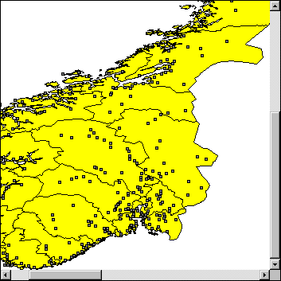
Grouping
Ola Nordmann lives in Hansegata 3, Andebu and earns 320.000 kr. per year
If we zoom in the map we can
show characteristics of Ola
If we zoom out we get
aggregated data: Total income,
Average income distributed on
sex, age, etc

Slide 30
To types of columns
AnsattNr | Etternavn | Fornavn | Stilling | Lønn
1 | Veum | Varg | Selger | 300 000
2 | Stein | Trude | Programmerer | 400 000
3 | Dudal | Inger-Lise | Sekretær | 300 000
4 | Hansen | Hans | Programmerer | 500 000
5 | Bjørnsen | Henrik | Selger | 500 000
6 | Gredelin | Sofie | Direktør | 800 000
7 | Zimmermann | Robert | Programmerer | 600 000
Column Lønn: compute sum, average, …
Column Stilling: Create «groups», e.g.,
average for each type of position (group)

Slide 31
Common functions
Operations on one value, e.g.,:
UPPER: capital letters
YEAR: extract year from the date
Operations on a set of values:
AVG(kolnavn) average
SUM(kolnavn) sum
COUNT(*) number
MIN(kolnavn) minimum
MAX(kolnavn) maximum

Slide 32
Functions computing statistics
Average salary:
SELECT AVG(Årslønn) AS SnittLønn
FROM Ansatt
What about total salary cost ?
Or average salary for programmers ?
SnittLønn
485 714
1 rad!
1 kolonne!

Slide 33
COUNT and null
Number of employees (= number of rows):
SELECT COUNT(*) FROM Ansatt
Number of employees with registered salary:
SELECT COUNT(Årslønn) FROM Ansatt
COUNT(Årslønn) does not count rows with null
A bad attempt of computing average:
SELECT SUM(Årslønn)/COUNT(*) FROM Ansatt
Use AVG(Årslønn) in stead!

Slide 34
Grouping
Find average salary for ech position (stilling)
SELECT Stilling, AVG(Årslønn)
FROM Ansatt
GROUP BY Stilling
Stilling has a only few values !
Grouping of columns must be included in the result

Slide 35
Query results
To find average salary for each position we need to form groups: selgere, programmer, …
Then we compute average salary for each group
The result gives 4 rows because there are 4 different positions
Stilling | Lønn
Sekretær | 300 000
Programmerer | 500 000
Selger | 400 000
Direktør | 800 000

Slide 36
Group condition (HAVING)
What is the result here ?
SELECT Stilling, AVG(Årslønn), COUNT(*)
FROM Ansatt
GROUP BY Stilling
HAVING AVG(Årslønn) > 450000
HAVING on groups corresponds to WHERE on rows.
Note: It is not legal to use statistical functions in WHERE conditions.

Slide 37
Group conditions and row conditions
Conditions on rows and on groups:
SELECT Stilling, AVG(Årslønn), COUNT(*)
FROM Ansatt
WHERE Year(AnsattDato) > 1990
GROUP BY Stilling
HAVING AVG(Årslønn) > 280000
Why can’t we merge the two conditions ?

Slide 38
Construction of select queries
SELECT queries to 1 table follows this pattern:
SELECT Which columns to select?
FROM From which columns?
WHERE which rows to include ?
GROUP BY Group on which columns ?
HAVING which groups to include?
ORDER BY Sort on which columns?
You don’t need to include all these in a query
We will add more command words
SELECT is only one of several SQL commands…

Slide 39
Øvinger
Mandatory exercise 1
Deadline friday 23. february at 16.00
week 8
Work in your group and hand in commun common on Canvas
Exercise 2 Import of data
Carry out commands from the book

Slide 40
Noen demonstrasjoner
Plenumsgjennomgangen mandag
Tabellen “vare” fra læreboka
Vi skal se på noen eksempler
MYSQL terminal/Kommandolinje

